Slide 1
QA SIMULATION PROJECT
Nithya Viswanathan
Sekar Gayathri
Lauri Kyttälä
Suman Basnet

Slide 2
SMART-SENSOR Mobile TESTING

Slide 3
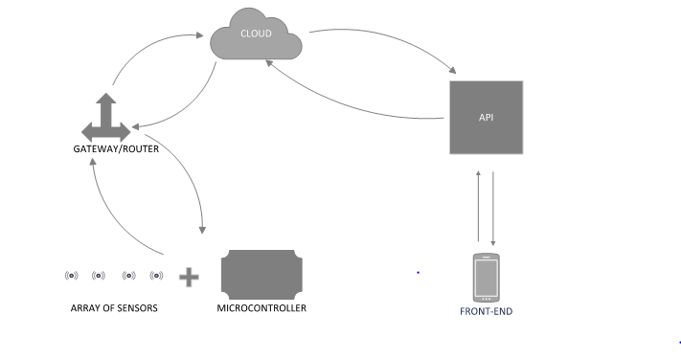
SMART-SENSOR Mobile TESTING
Test Methodology :: Agile Method
Test Modules ::
MODULE 1 :: IoT ---------- Cloud
SUB-MODULE 1 :: IoT
SUB-MODULE 2 :: IoT (SENSOR) to Gateway
SUB-MODULE 3 :: Gateway to Cloud
MODULE 2 :: Cloud ---------- Mobile / Desktop
SUB-MODULE 4 :: Cloud
SUB-MODULE 5 :: API

Slide 4
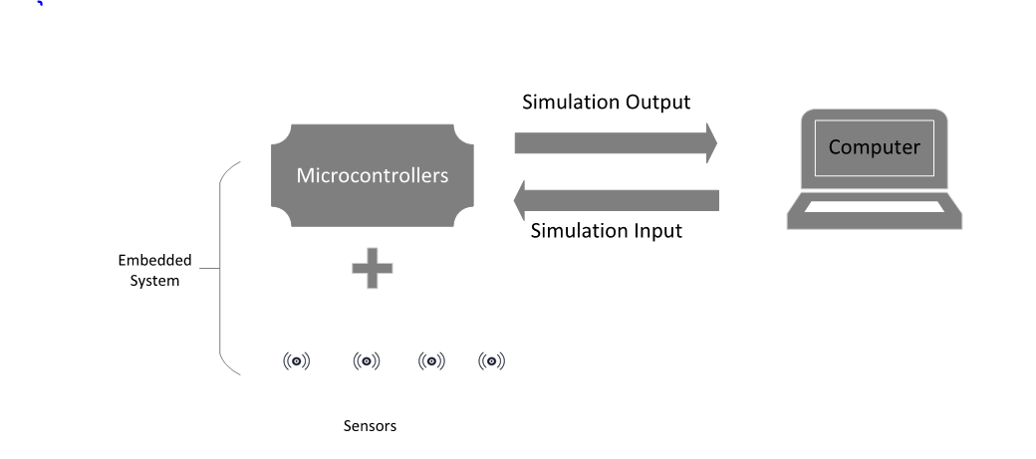
MODULE 1 :: IoT ---------- Cloud SUB-MODULE 1 :: IoT Test Environment
Test levels
Usability testing (easy for end user/tester)
Security testing (To test the data is encrypted)

Slide 5
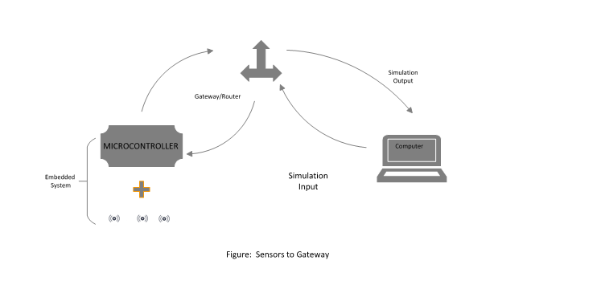
SUB-MODULE 2 :: IoT (SENSOR) to Gateway
TEST ENVIORNMENT
Test level ::
Performance testing (multiple sensor / 24 x7)
Security testing
Network testing
Compatibility testing(since s/w & h/w are used in sensor
Tools :: Spirent (to trigger packet and check authenticity) Automation :: Network testing, Performance testing

Slide 6
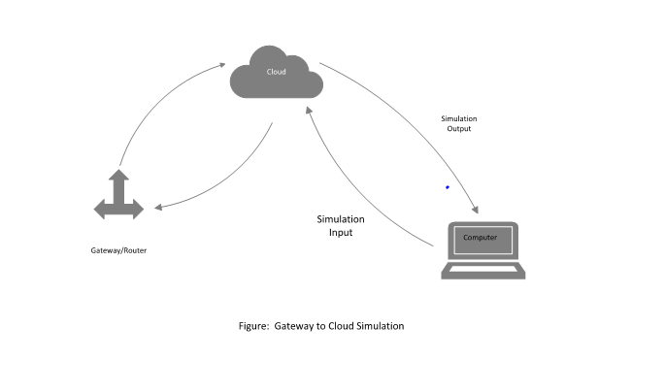
SUB-MODULE 3 :: Gateway to Cloud
TEST ENVIRONMENT
TEST levels
Network testing
Performance testing (multiple sensor / 24 x7)
Security testing (since its connected to network)
Stability testing
Tools :: Spirent (to trigger packet and check authenticity)

Slide 7
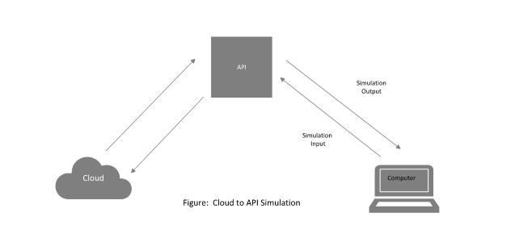
MODULE 2 :: Cloud ---------- Mobile / Desktop SUB-MODULE 4 :: Cloud / API
TEST ENVIRONMENT
TEST level::
Performance testing (Load, Scalability, Stress)
Functionality (Error handling, Parameters tested, Negative testing)
Test tools :: JMeter, Shodan (to check the device connectivity on network)
Automation :: Functionality , Performance testing

Slide 8
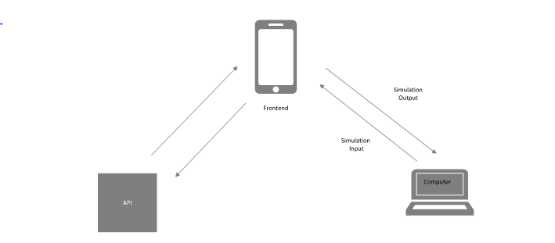
SUB-MODULE 5 :: API to Mobile
TEST ENVIRONMENT
TEST levels
Performance testing (load, scalability, Stress)
Functionality (Usability,
Test tools::Jmeter for performance testing , PostMan for functionality testing, BURP for security testing
Automation :: Functionality

Slide 9
Test Automation
Automation tools:: Robot Framework (?), Spirent libraries, Jmeter, RESTAssured
TEST bugs handled by JIRA

